Slide 1
INTELLIGENT CI/CD ORCHESTRATOR
MILESTONE 2
Group Members:
Syed Muhammad Haider Ali Naqvi (23SP-032-SE)
Syeda Zainab Fatima (23SP-055-SE)
Muddassir Ghulam Sarwar (23SP-011-SE)
Syed Muhammad Saqib Hassan (23SP-013-SE)
Supervisor:
Engr. Laiba Mughal

Slide 2
POC Requirements
POC: Dynamic Queue Optimization — Custom Jenkins Plugin
The team was assigned to build a Jenkins plugin that automatically reorders the build queue by scoring each job using this formula:
Score = 0.5 × Urgency + 0.3 × Dependency + 0.2 × Execution Time
Three components inside the plugin:
QueueTaskDispatcher — blocks jobs whose dependencies haven't finished yet
QueueSorter — uses a Max-Heap to always pull the highest-scored job next
Score Formula Engine — calculates and updates scores in real time

Slide 3
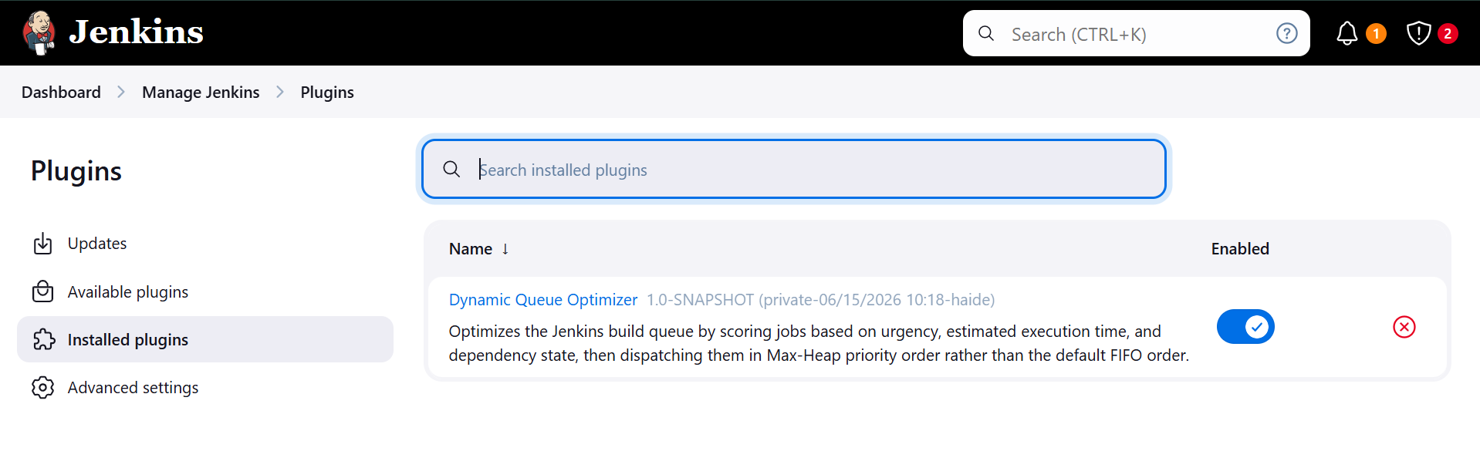
POC Demonstration

Slide 4
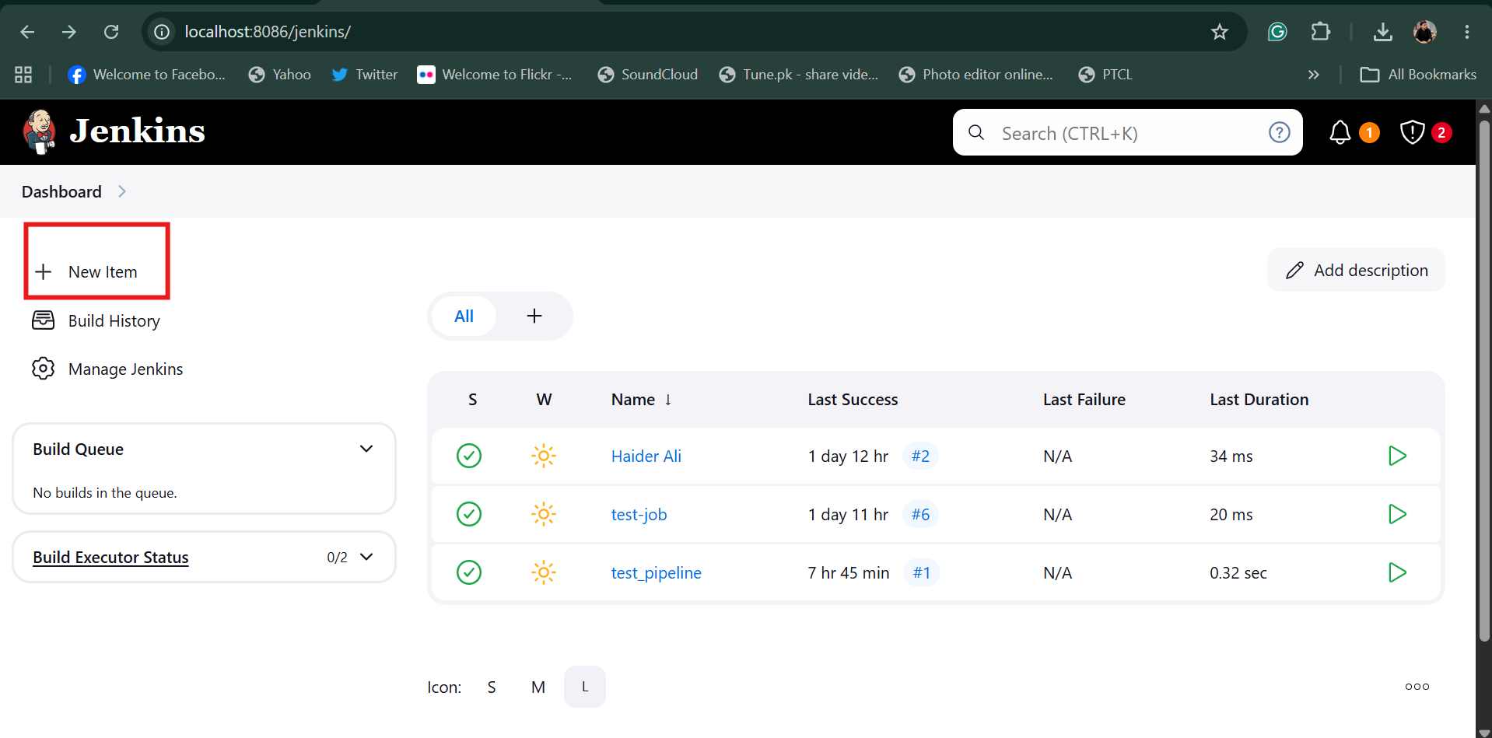
With plugin

Slide 5
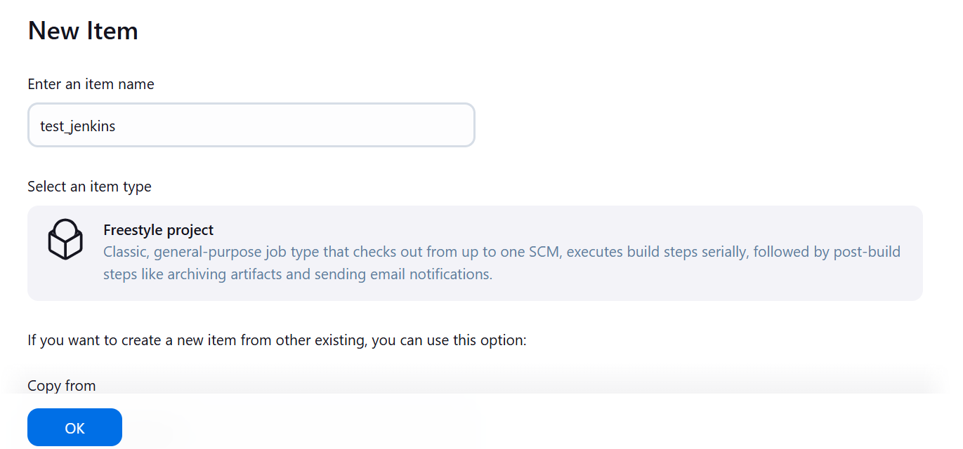

Slide 6
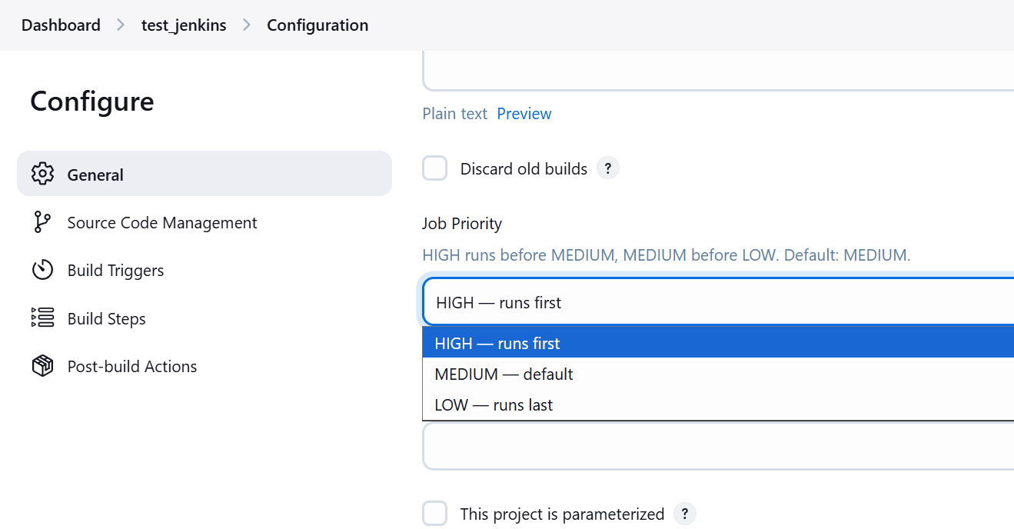

Slide 7
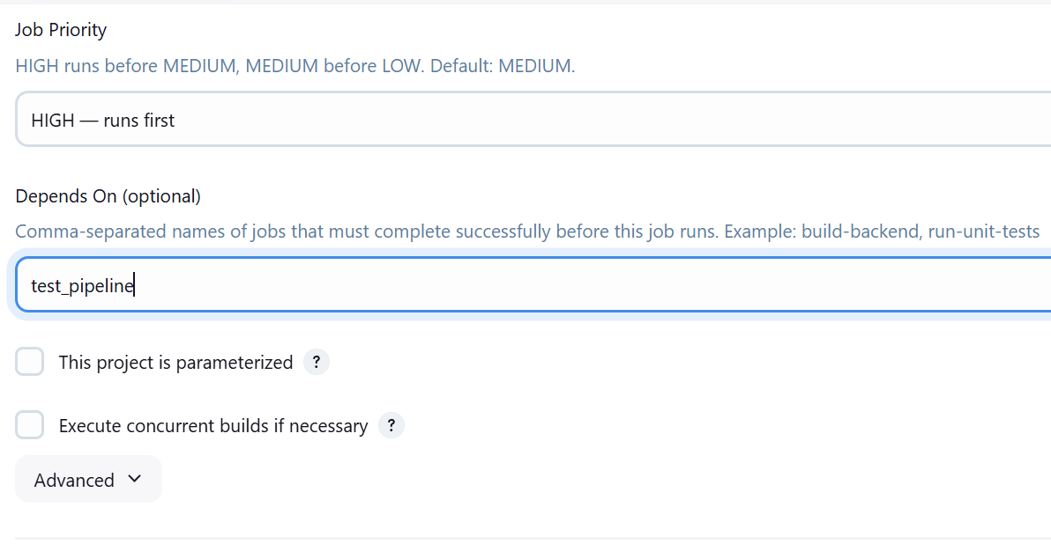

Slide 8
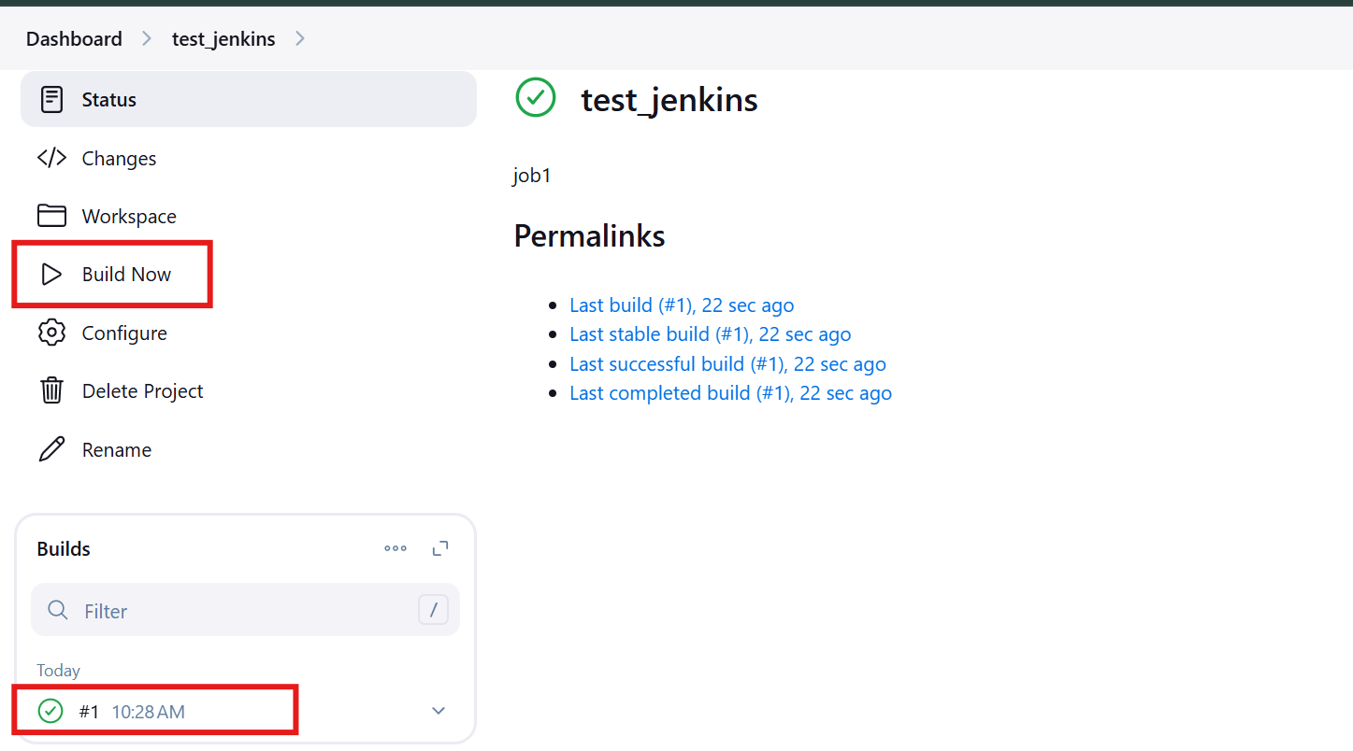

Slide 9
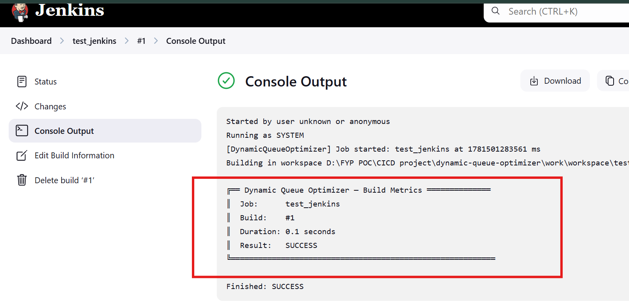

Slide 10
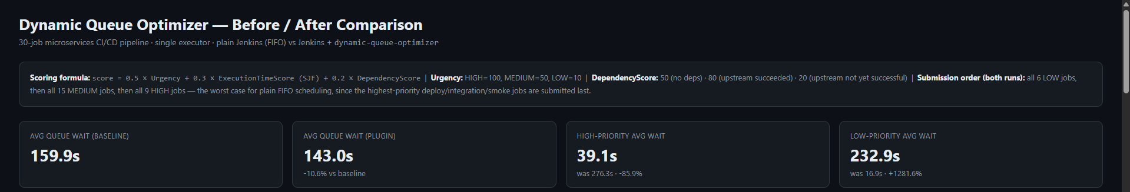
POC Demonstration
Comparison without plugin and plugin:

Slide 11
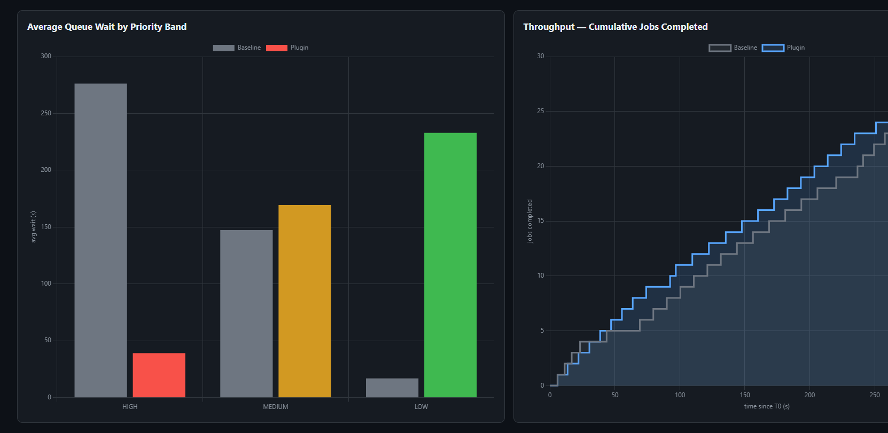

Slide 12
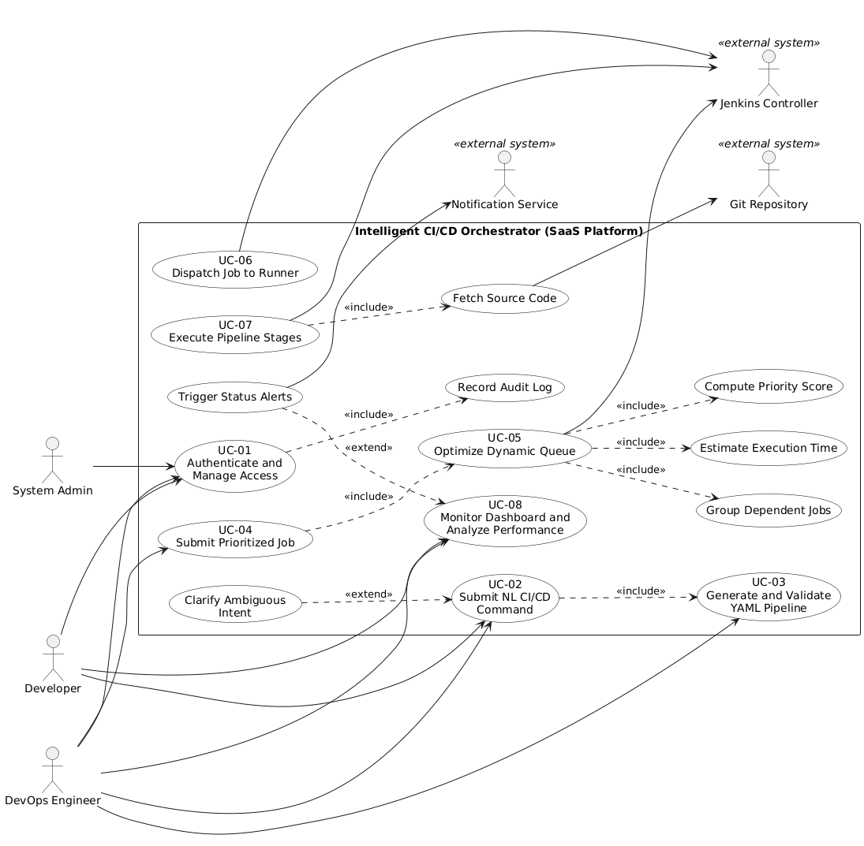
Revised Actor Use Case Diagram

Slide 13
Revised Actor Use Case Diagram
ID | Use case | Primary actors | Supporting actors / systems
UC-01 | Authenticate and Manage Access | Developer, DevOps Engineer, System Admin | PostgreSQL
UC-02 | Submit NL CI/CD Command | Developer, DevOps Engineer | LLM service
UC-03 | Generate and Validate YAML Pipeline | DevOps Engineer | LLM service, Jenkins
UC-04 POC | Submit Prioritized Job | DevOps Engineer | Jenkins Controller
UC-05 POC | Optimize Dynamic Queue | System (plugin) | Jenkins Controller, PostgreSQL
UC-06 POC | Dispatch Job to Runner | System (plugin) | Jenkins Controller
UC-07 | Execute Pipeline Stages | Jenkins Controller | Git Repository
UC-08 | Monitor Dashboard and Analyze Performance | Developer, DevOps Engineer | Notification Service, PostgreSQL

Slide 14
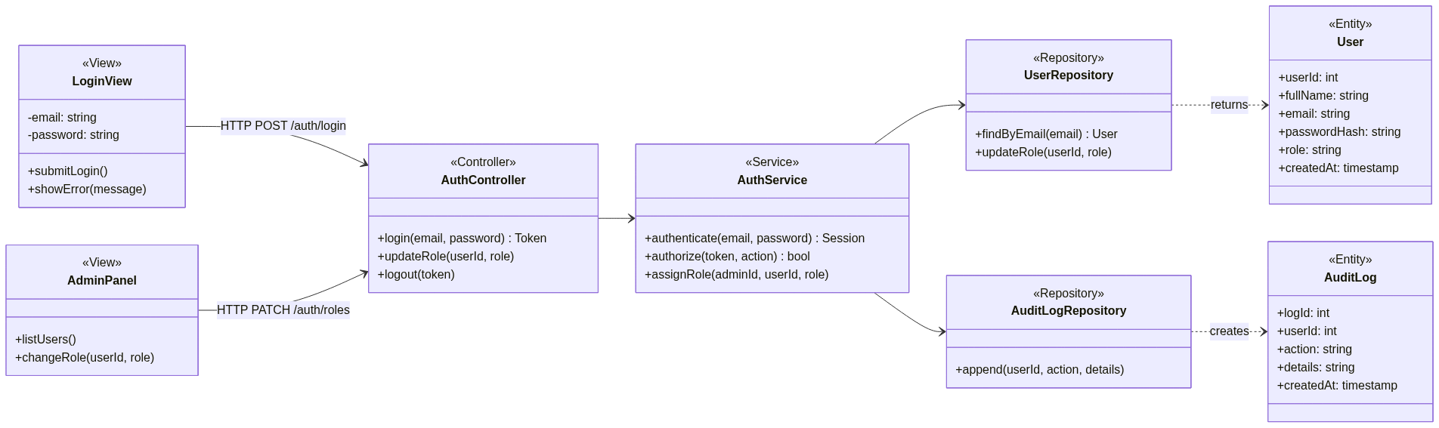
UC-01: Authenticate and Manage Access
Class Diagram

Slide 15
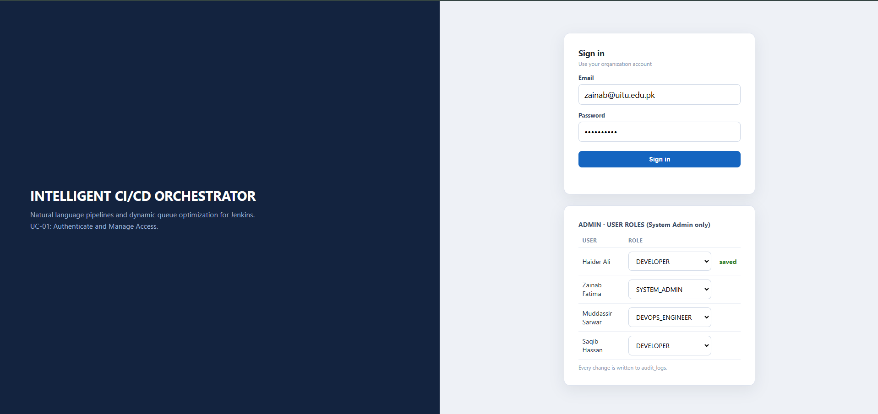
UC-01: Authenticate and Manage Access
Frontend GUI
(login screen and admin role panel)

Slide 16
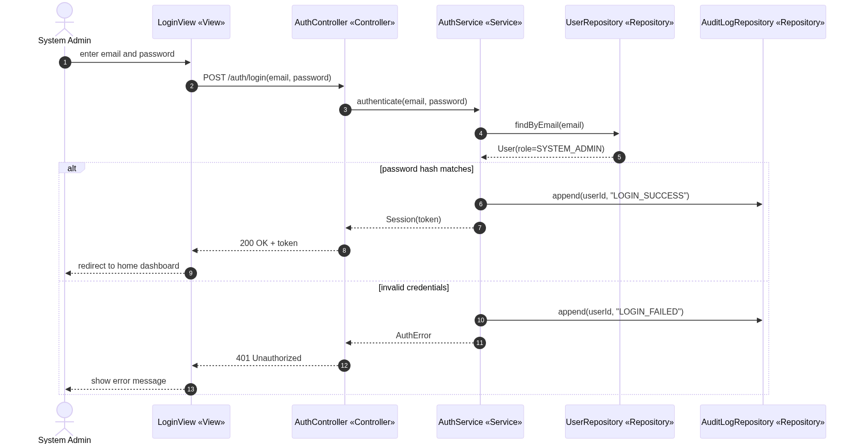
UC-01: Authenticate and Manage Access
Sequence Diagram

Slide 17
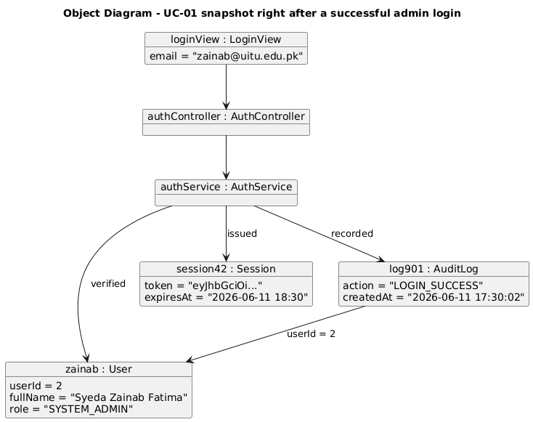
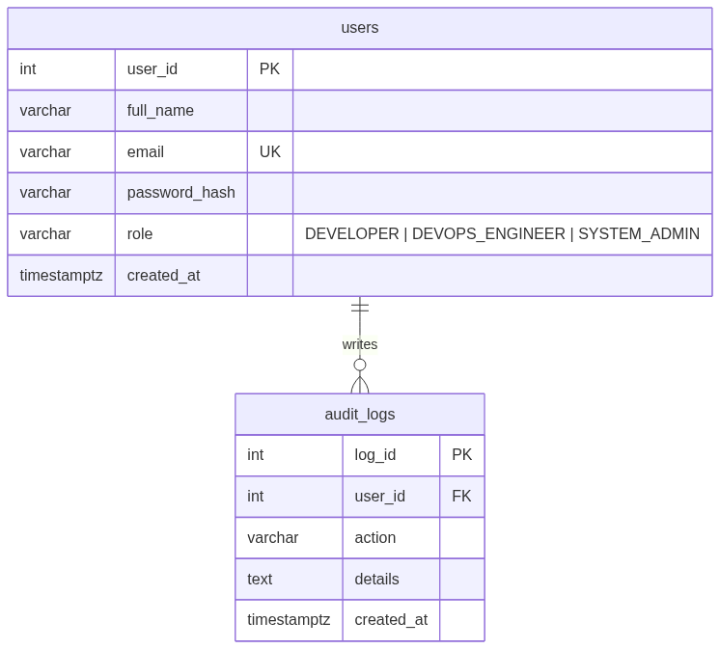
UC-01: Authenticate and Manage Access
Object Diagram + ER Diagram
ERD fragment for UC-01 (users, audit_logs)

Slide 18
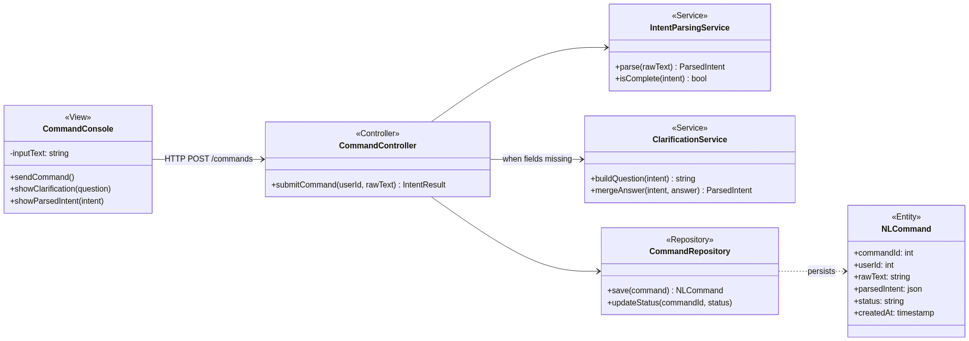
UC-02: Submit NL CI/CD Command
Class Diagram

Slide 19
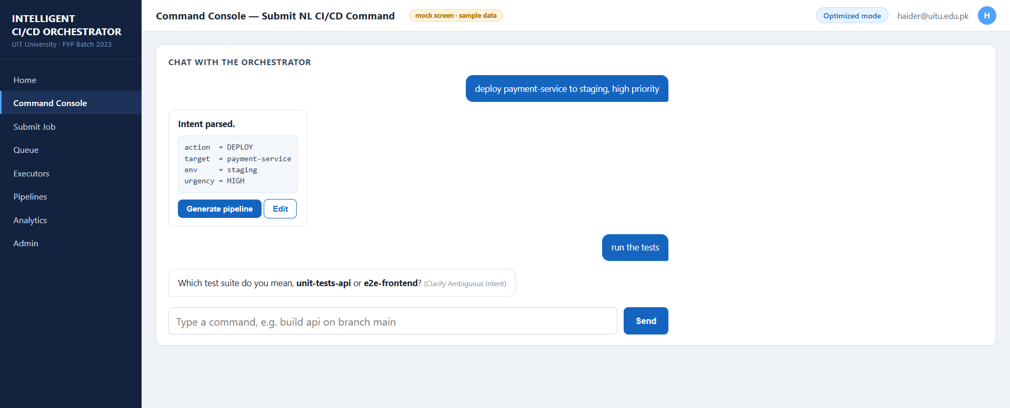
UC-02: Submit NL CI/CD Command
Frontend GUI
(command console with clarification prompt)

Slide 20
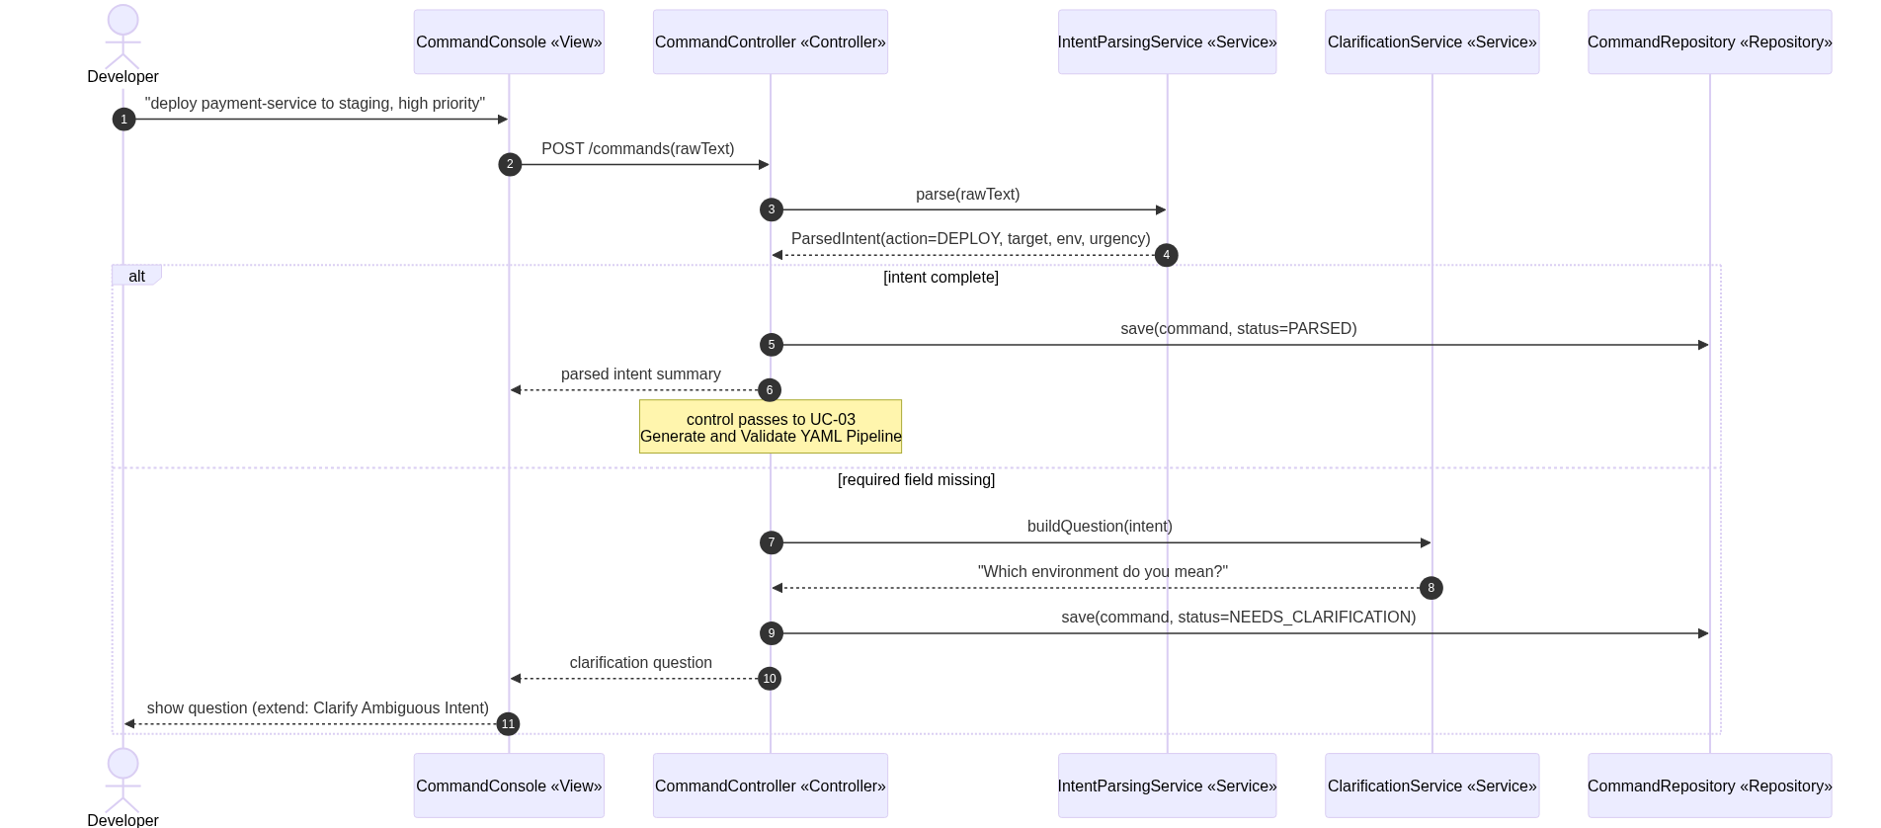
UC-02: Submit NL CI/CD Command
Sequence Diagram

Slide 21
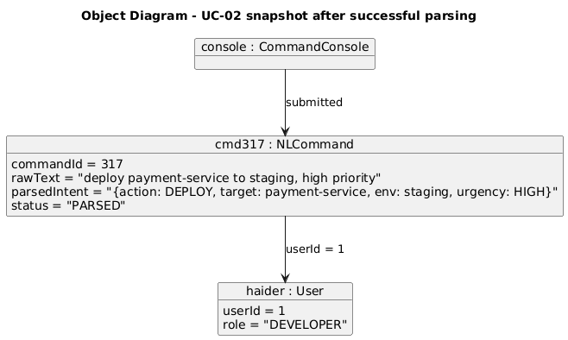
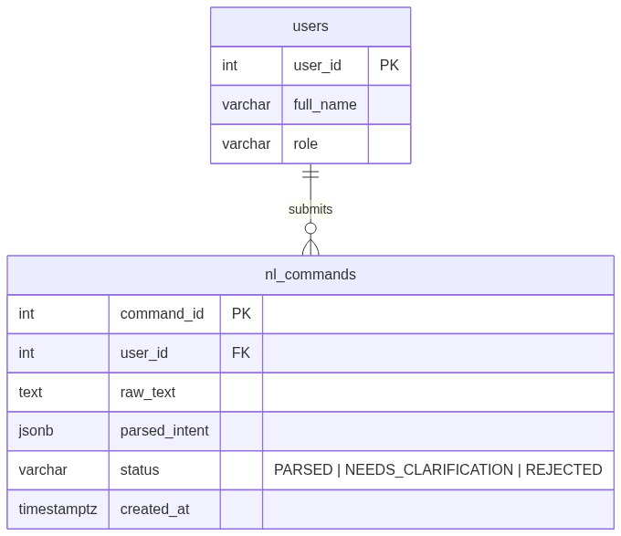
UC-02: Submit NL CI/CD Command
Object Diagram + ER Diagram
ERD fragment for UC-02 (users, nl_commands)

Slide 22
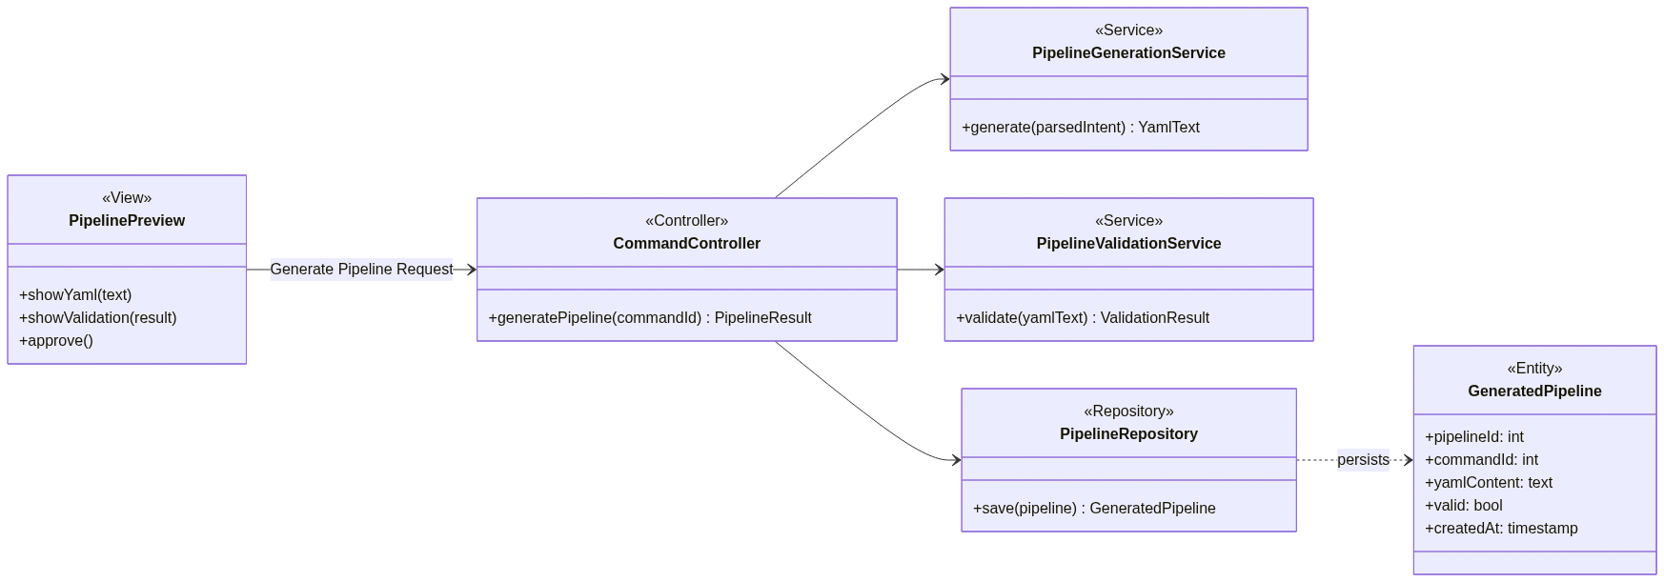
UC-03: Generate and Validate YAML Pipeline
Class Diagram

Slide 23
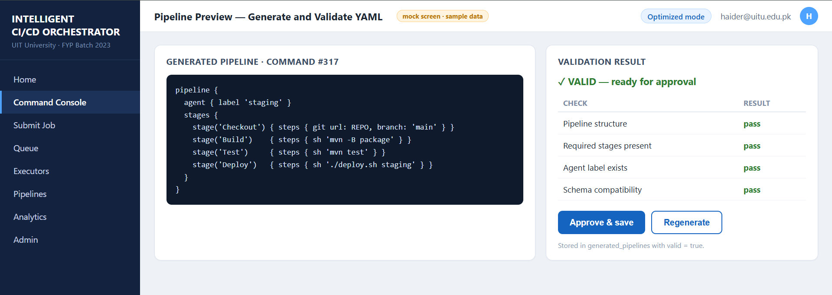
UC-03: Generate and Validate YAML Pipeline
Frontend GUI
(pipeline preview with validation result)

Slide 24
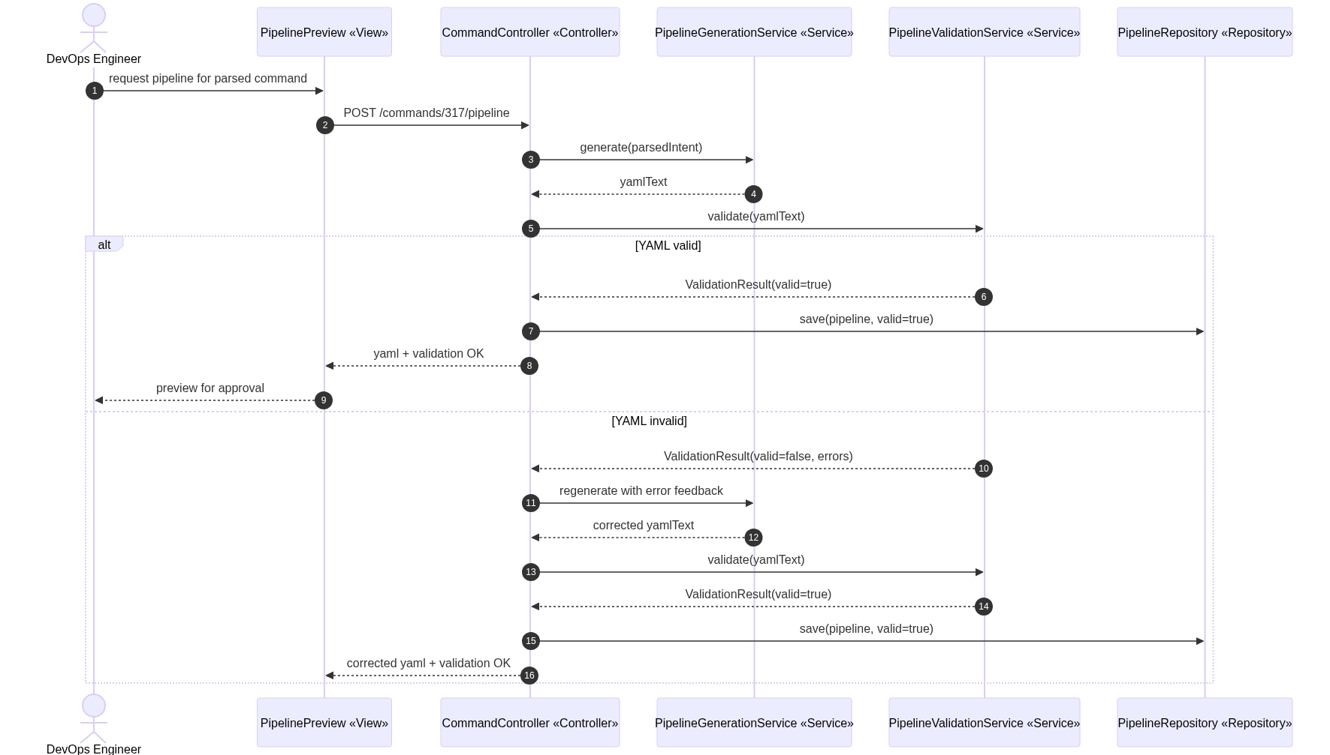
UC-03: Generate and Validate YAML Pipeline
Sequence Diagram

Slide 25
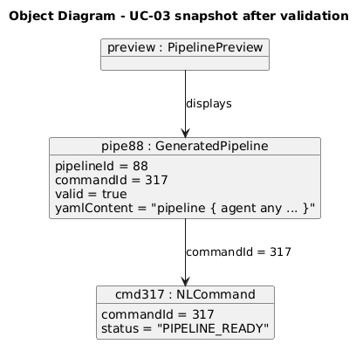
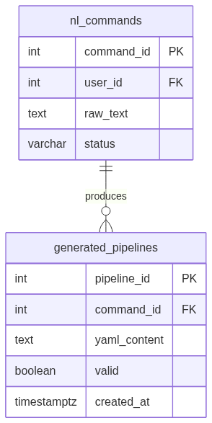
UC-03: Generate and Validate YAML Pipeline
Object Diagram + ER Diagram
ERD fragment for UC-03 (nl_commands, generated_pipelines)

Slide 26
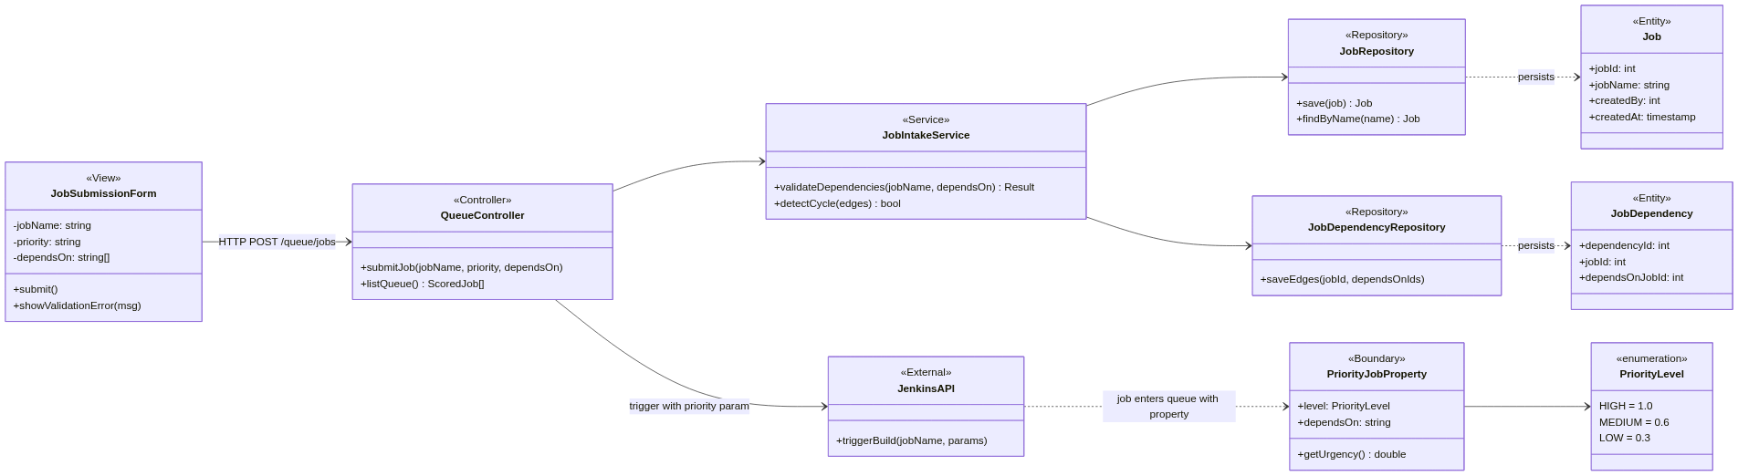
UC-04: Submit Prioritized Job
Class Diagram

Slide 27
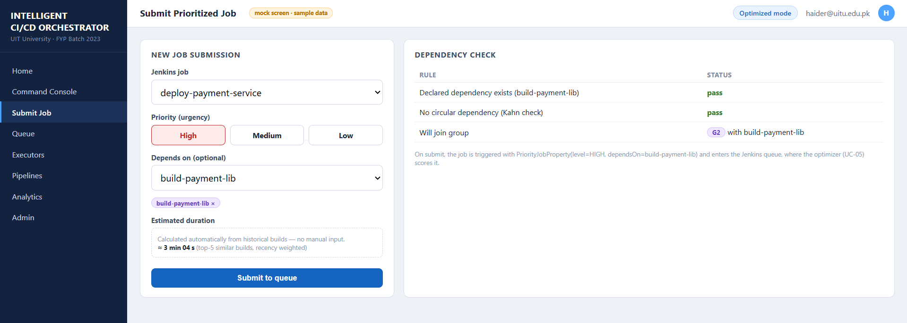
UC-04: Submit Prioritized Job
Frontend GUI
(job submission form with priority and dependencies)

Slide 28
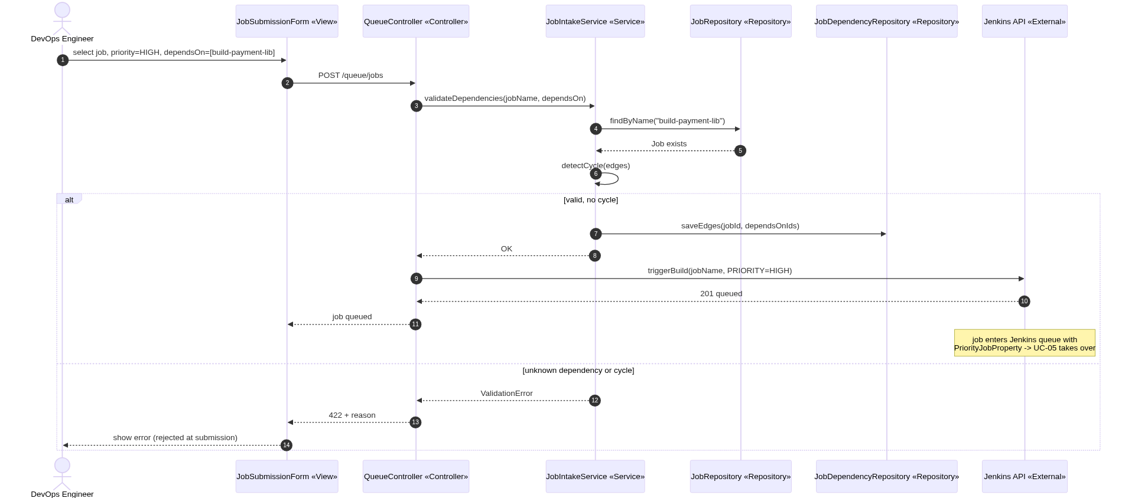
UC-04: Submit Prioritized Job
Sequence Diagram

Slide 29
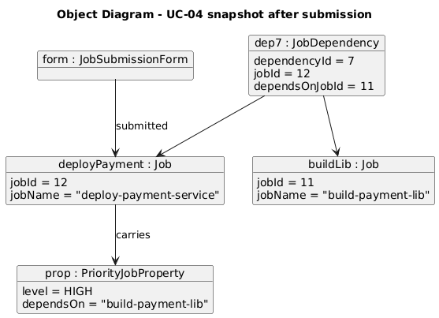
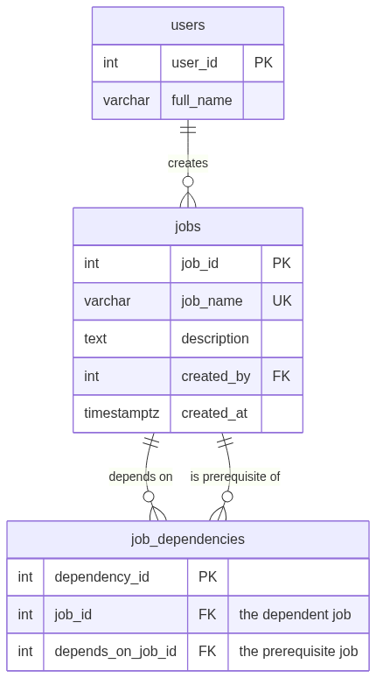
UC-04: Submit Prioritized Job
Object Diagram + ER Diagram
ERD fragment for UC-04 (jobs, job_dependencies)

Slide 30
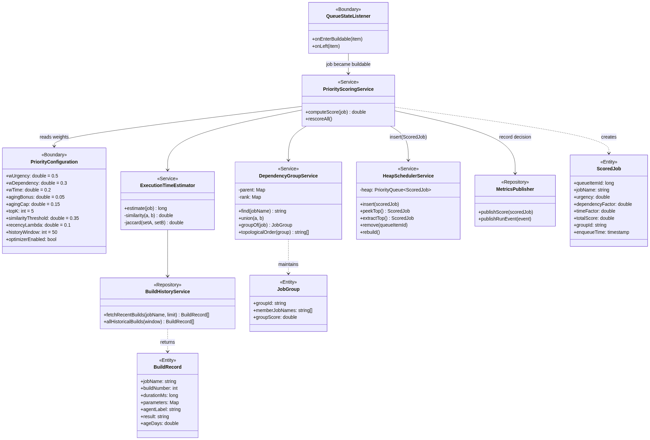
UC-05: Optimize Dynamic Queue (POC Core)
Class Diagram

Slide 31
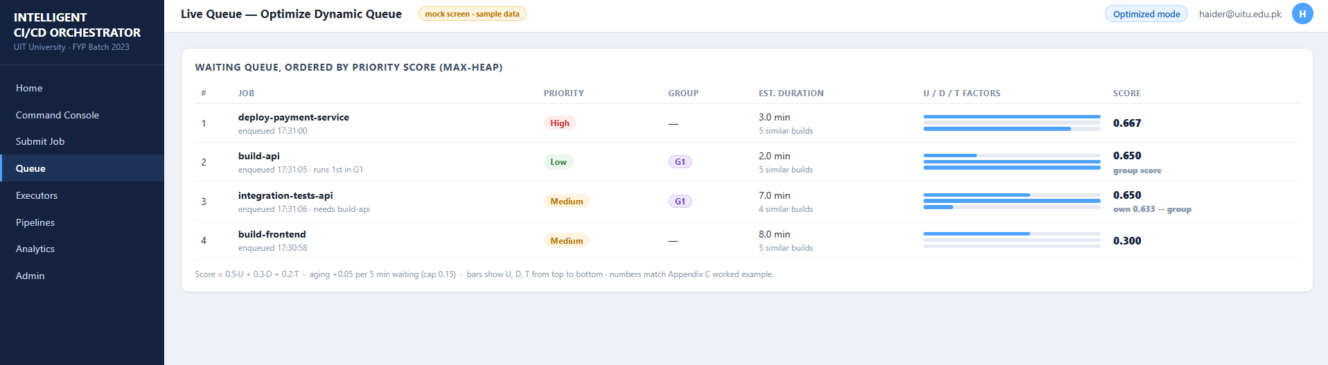
UC-05: Optimize Dynamic Queue (POC Core)
Frontend GUI
(live queue board with priority scores)

Slide 32
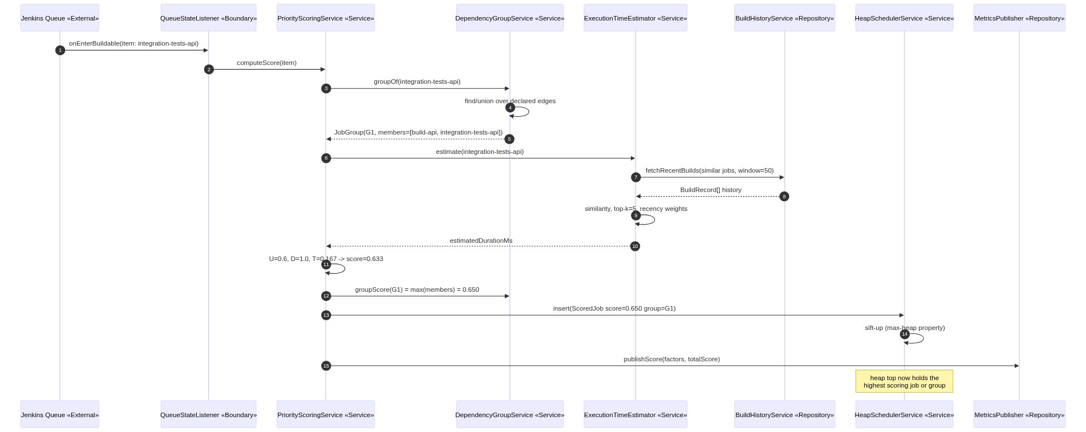
UC-05: Optimize Dynamic Queue (POC Core)
Sequence Diagram

Slide 33
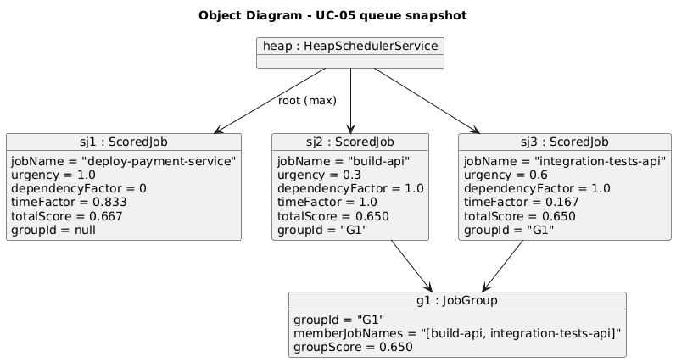
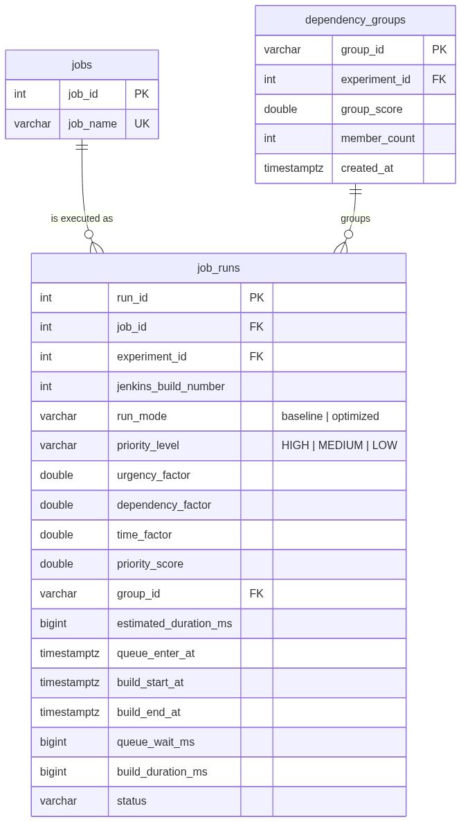
UC-05: Optimize Dynamic Queue (POC Core)
Object Diagram + ER Diagram
ERD fragment for UC-05 (jobs, job_runs, dependency_groups)

Slide 34
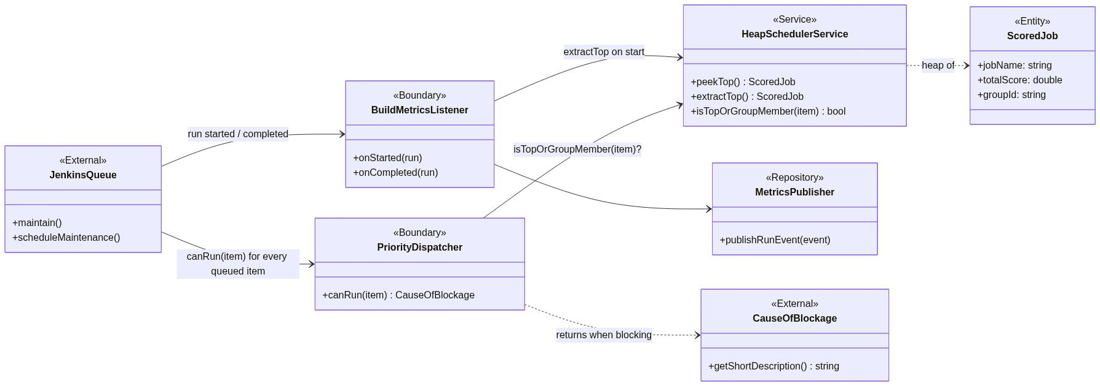
UC-06: Dispatch Job to Runner
Class Diagram

Slide 35
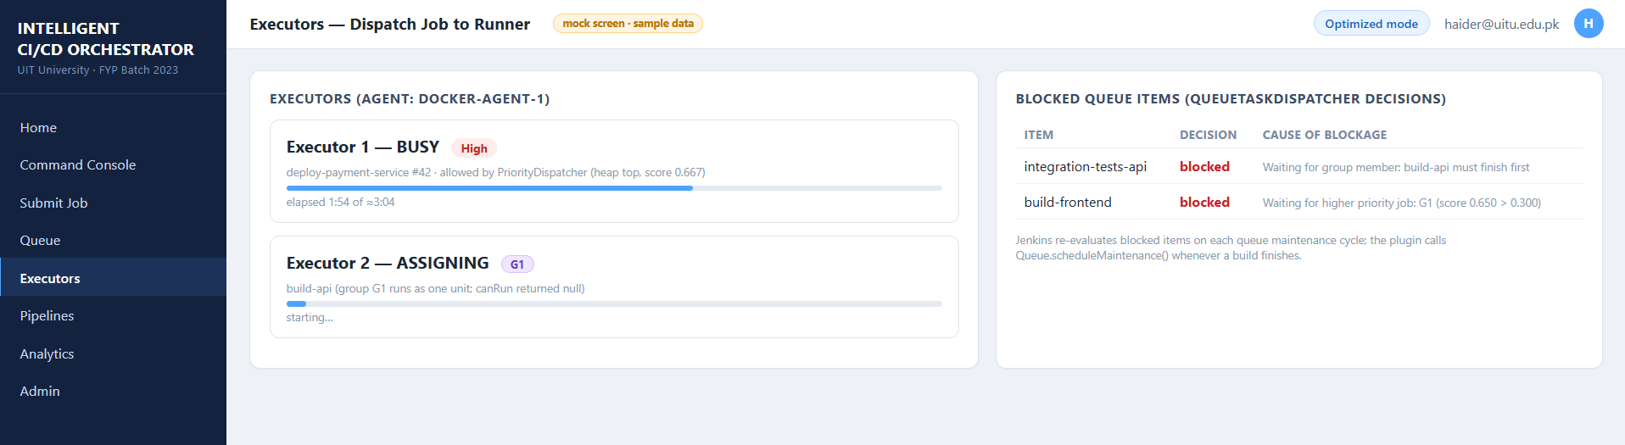
UC-06: Dispatch Job to Runner
Frontend GUI
(executors panel showing the dispatch decision)

Slide 36
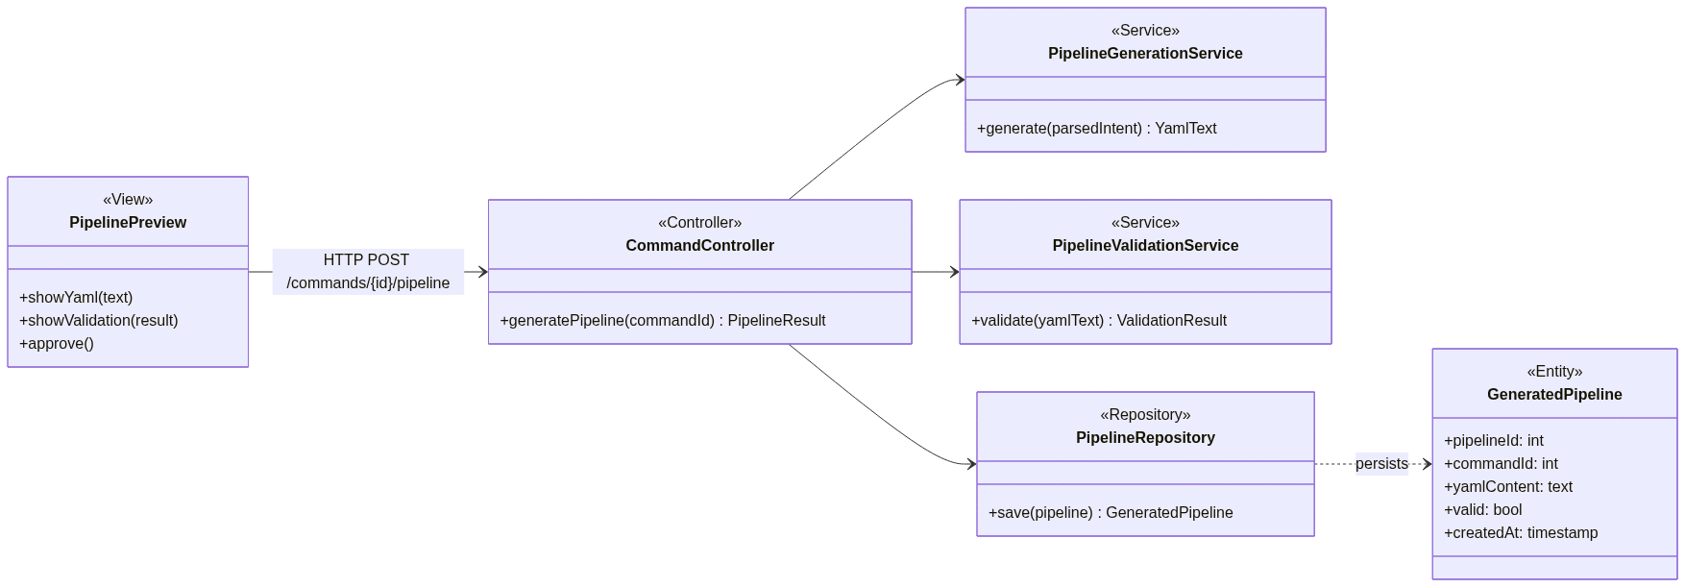
UC-06: Dispatch Job to Runner
Sequence Diagram

Slide 37
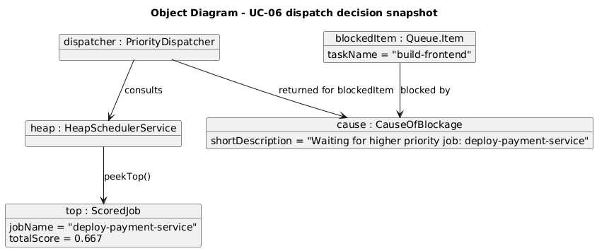
UC-06: Dispatch Job to Runner
Object Diagram + ER Diagram
The ERD is shared with UC-05, so we do not repeat it here.

Slide 38
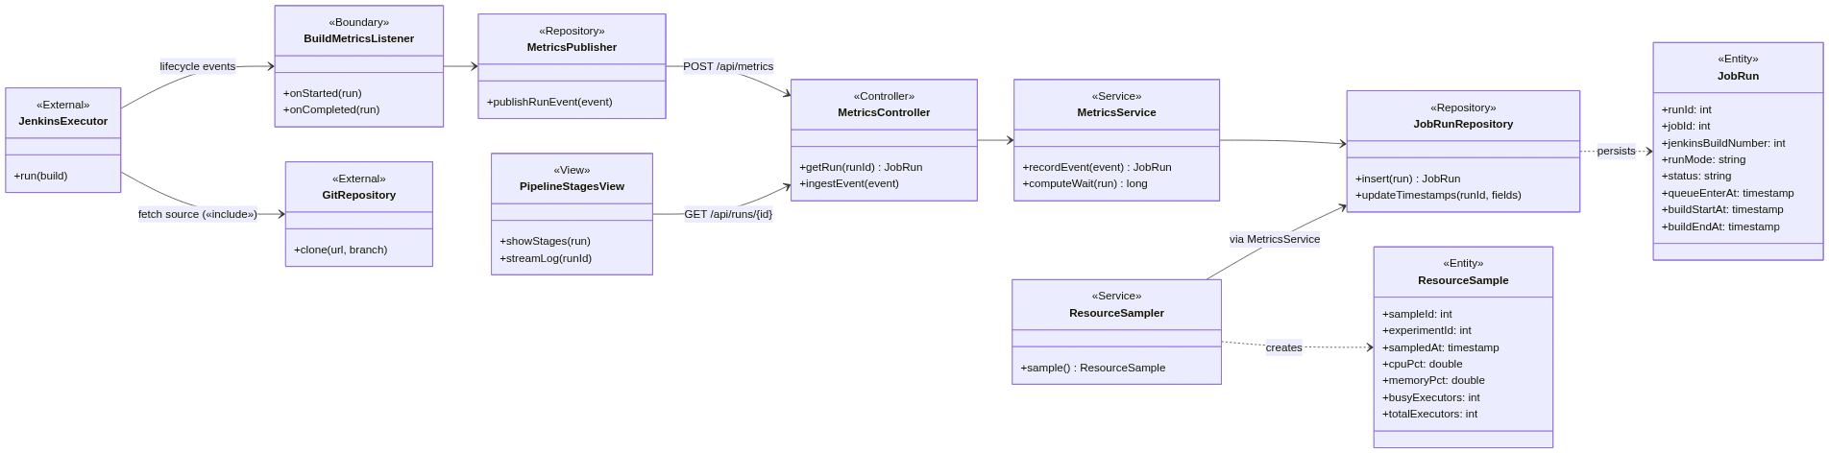
UC-07: Execute Pipeline Stages
Class Diagram

Slide 39
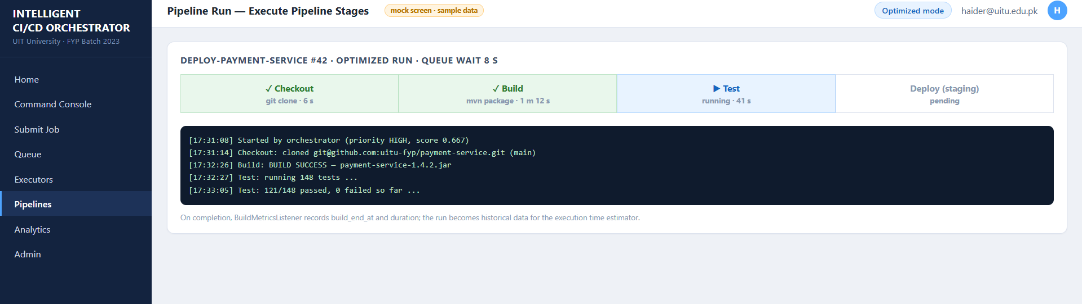
UC-07: Execute Pipeline Stages
Frontend GUI
(pipeline stages view with live status)

Slide 40
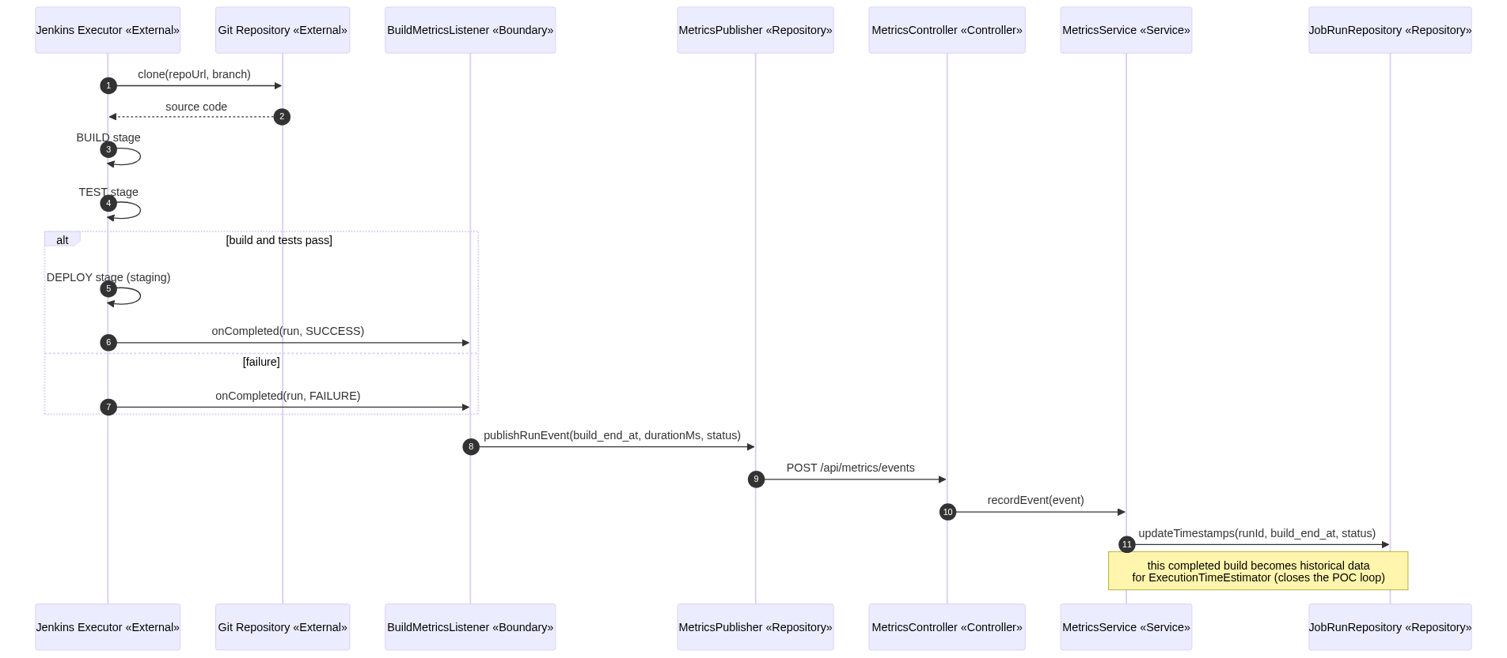
UC-07: Execute Pipeline Stages
Sequence Diagram

Slide 41
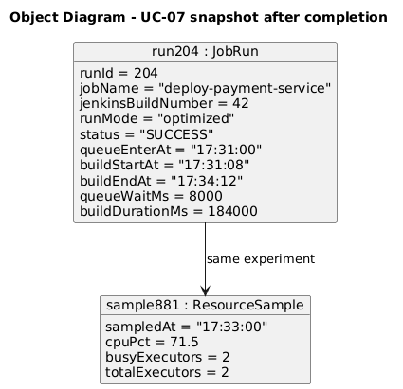
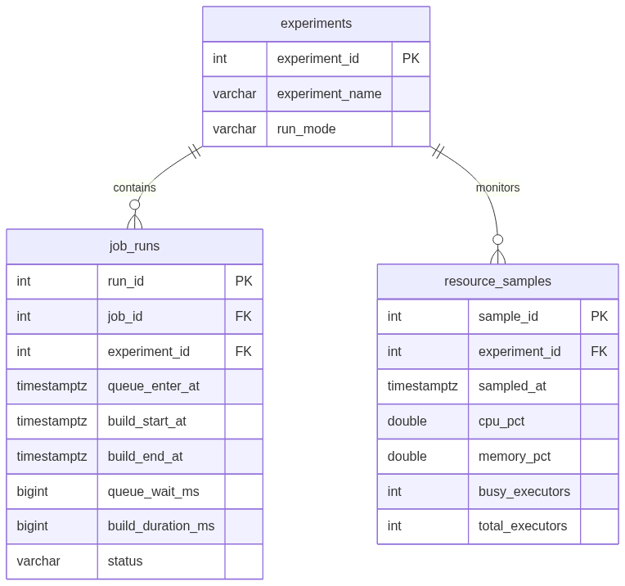
UC-07: Execute Pipeline Stages
Object Diagram + ER Diagram
ERD fragment for UC-07 (job_runs, resource_samples)

Slide 42
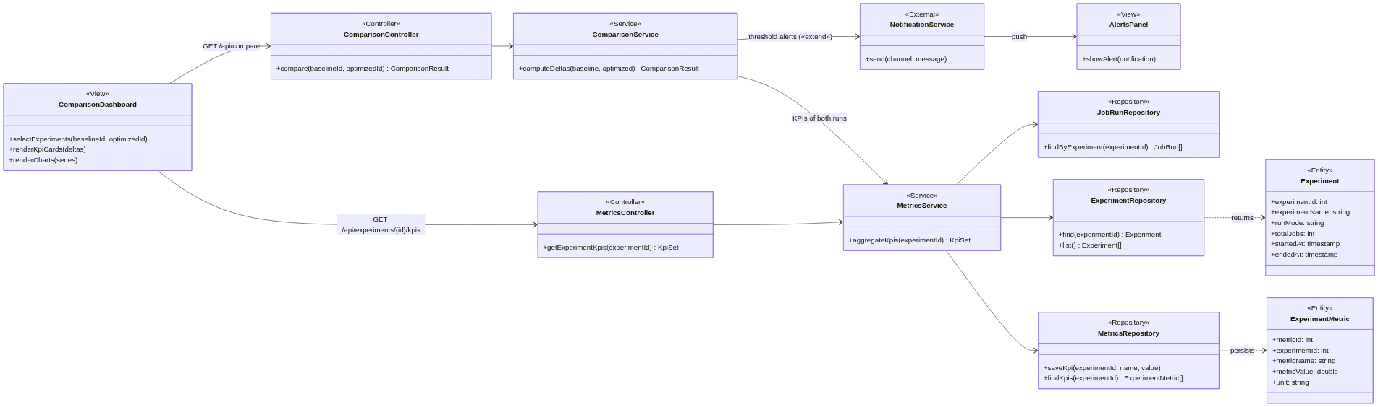
UC-08: Monitor Dashboard and Analyze Performance
Class Diagram

Slide 43
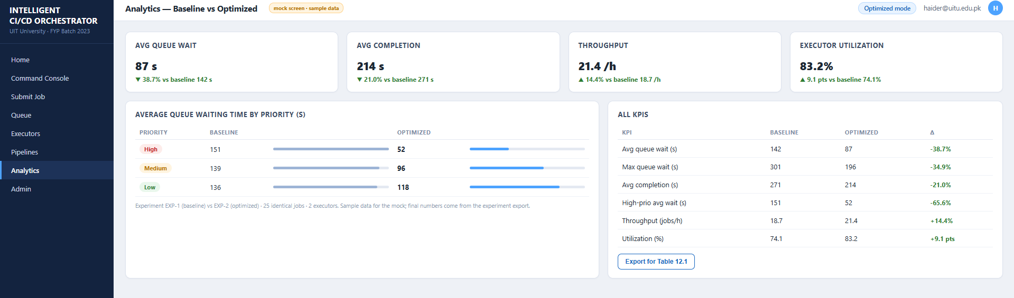
UC-08: Monitor Dashboard and Analyze Performance
Frontend GUI
(baseline versus optimized comparison dashboard)

Slide 44
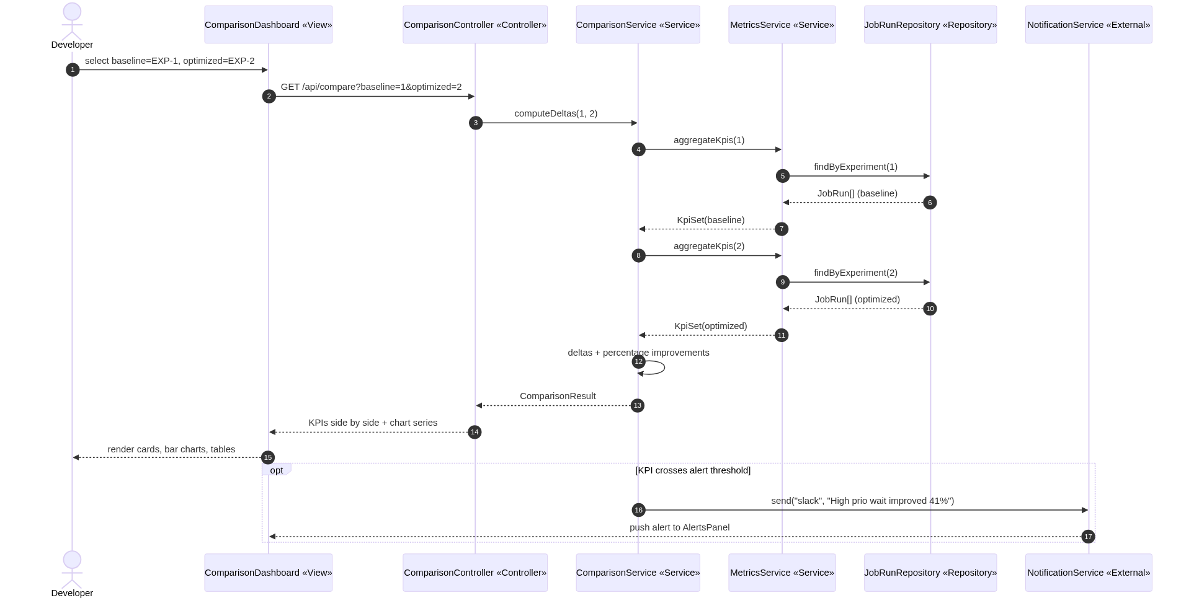
UC-08: Monitor Dashboard and Analyze Performance
Sequence Diagram

Slide 45
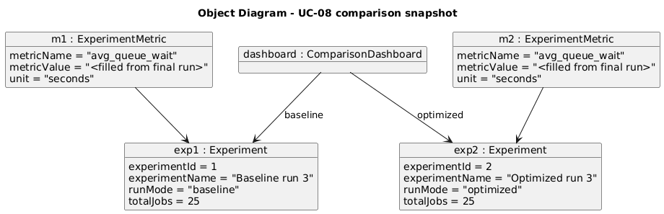
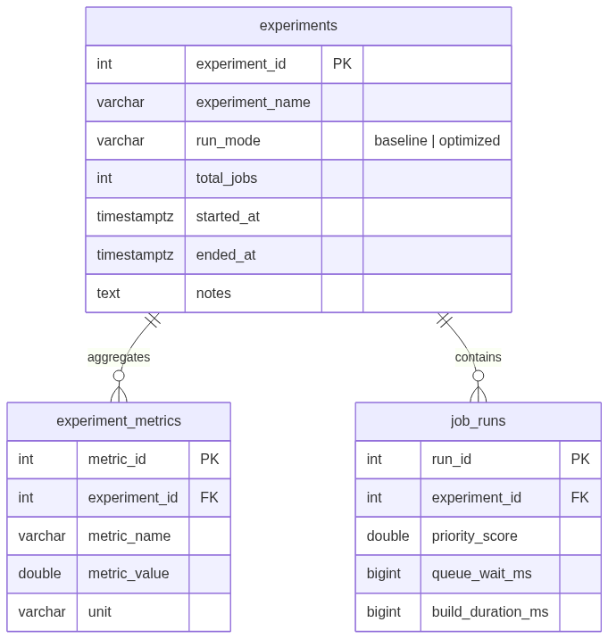
UC-08: Monitor Dashboard and Analyze Performance
Object Diagram + ER Diagram
ERD fragment for UC-08 (experiments, experiment_metrics, job_runs)

Slide 46
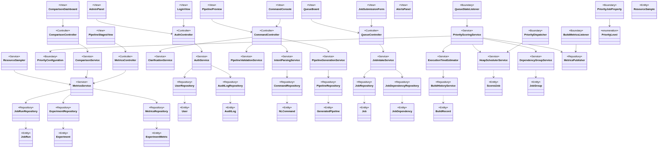
Complete Class Diagram

Slide 47

Complete Database Schema

Slide 48
Algorithm 1 — Weighted Priority Scoring
Significance:
Each Jenkins job gets a priority score to decide which job runs first. It replaces FIFO by giving preference to urgent and dependency-heavy jobs while preventing starvation using aging.
Pseudocode:
    FUNCTION calculateScore(job):
    U = normalize(urgency)
    D = normalize(dependency)
    T = normalize(executionTime)
    score = (0.5*U) + (0.3*D) + (0.2*T)
    aging = MIN(waitTime/5min * 0.05, 0.15)
    RETURN score + aging
Where:
U: Job urgency (50%)
D: Dependency factor (30%)
T: Execution time factor (20%)
Aging: Gives waiting jobs extra priority to avoid starvation.

Slide 49
Algorithm 1 — Weighted Priority Scoring
Comparison:
Approach | Best | Average | Worst | Space
Our Weighted Formula | O(1) | O(1) | O(n) | O(1)
Simple Priority Levels | O(1) | O(1) | O(1) | O(1)
ML-Based Scoring | O(n) | O(n log n) | O(n²) | O(n)
Why our approach wins:
Faster than ML scoring (no training needed)
More accurate than simple priority levels
Handles urgency, dependencies, and waiting time together
Only extra cost is rare O(n) renormalization

Slide 50
Algorithm 2 — Max-Heap Based Scheduling
Significance:
Max-Heap always selects the highest priority job in O(log n), making scheduling faster than arrays or linked lists.
Pseudocode:
  FUNCTION insert(job):
  heap.add(job)
  bubbleUp() // O(log n)
  FUNCTION getNext():
  top = heap[0]
  replace with last element
  bubbleDown() // O(log n)
  RETURN top
Where:
Insert: Adds a new job and maintains heap order
Peek: Gets highest priority job instantly
Extract: Removes and reorganizes heap
Space: Stores all jobs in heap

Slide 51
Algorithm 2 — Max-Heap Based Scheduling
Comparison:
Approach | Insert | Peek | Extract | Space
Our Approach (Max-Heap) | O(log n) | O(1) | O(log n) | O(n)
Sorted Array | O(n) | O(1) | O(1) | O(n)
Linked List | O(n) | O(n) | O(n) | O(n)
BST | O(log n) | O(log n) | O(log n) | O(n)
Why our approach wins:
Faster job extraction than arrays and linked lists
Highest priority job is always available in O(1)
Efficient for large Jenkins queues

Slide 52
Algorithm 3 — Dependency Grouping (Union-Find)
Significance:
Union-Find groups dependent jobs so a job runs only when its required dependencies are handled.
Pseudocode:
  FUNCTION groupDependencies(jobs, edges):
  FOR each job:
  makeSet(job)
  FOR each (a,b) in edges:
  union(a,b)
  FOR each job:
  group = find(job)
  addToGroup(group, job)
  RETURN groups
Where:
makeSet: Creates separate job groups
union: Combines dependent jobs
find: Identifies job group
Groups: Help prevent dependency conflicts

Slide 53
Algorithm 3 — Dependency Grouping (Union-Find)
Comparison:
Approach | Time | Space | Notes
Our Approach (Union-Find) | O(n + mα(n)) | O(n) | Very efficient
BFS/DFS Grouping | O(n + m) | O(n+m) | More memory usage
No Grouping | O(1) | O(1) | Dependency issues possible
Why our approach wins:
Faster dependency checking
Uses less memory
Prevents invalid job execution order

Slide 54
Algorithm 4 — Execution Time Estimation (Top-k Similarity)
Significance:
Predicts execution time using similar past jobs, improving the scheduling score.
Pseudocode:
  FUNCTION estimateTime(newJob, history):
  FOR each pastJob:
  similarity = compare(features)
  store(similarity, duration)
  topK = getTopK(k=5)
  RETURN weightedAverage(topK)
Where:
Similarity: Finds related previous jobs
Top-k: Selects closest matches
Weighted Average: Predicts execution time

Slide 55
Algorithm 4 — Execution Time Estimation (Top-k Similarity)
Comparison:
Approach | Best | Average | Worst | Space
Our Approach (Top-k Similarity) | O(h·f) | O(h·f) | O(h·f) | O(h)
Simple Average | O(h) | O(h) | O(h) | O(1)
Last Run Only | O(1) | O(1) | O(1) | O(1)
ML Model | O(1) Predict | High Training | High Training | O(n)
Why our approach wins:
No model training required
More accurate than simple average
Uses past job behavior for prediction
h = history size, f = feature count

